Slide 1
COMP 4830 Java Web Based Tutorial
Chun Li Lai T00246285
Hao Jin T00261895
Chengcheng Wang T00019928
Randeep Singh T00259104

Slide 2
Goal (purpose) of the project
What is the Purpose of developing this project?
Learning the purpose of Java in our daily life (attractive)
Goal of developing this project?
Help students learn better by interacting through multimedia.
Making learning fun.

Slide 3
Video for introduction of Java

Slide 4


Slide 5
Background
Bad learning experience
Concepts are not clear
Was afraid of programming
Hard to get help.
Make others to learn in better form.
Making easier ways to interact and even start our business on it.

Slide 6
Target User
TRU Students who takes COMP 1130
Computer Science students
Non-computer science students
JAVA Beginners

Slide 7
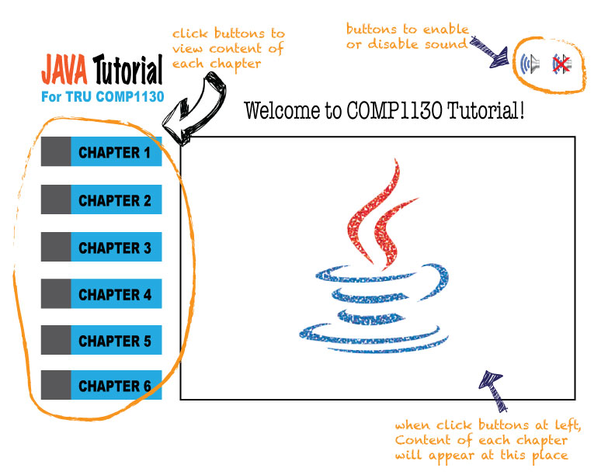
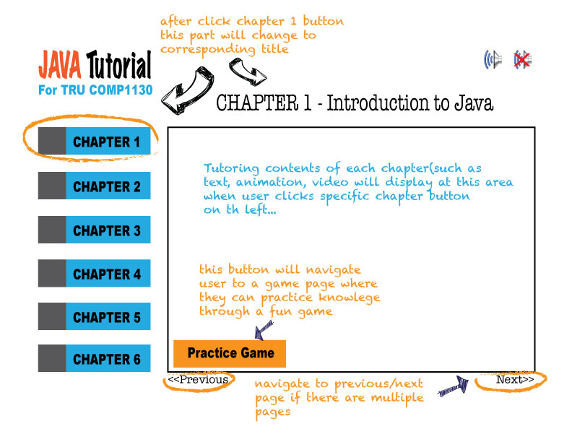
(GUI) Design
Initial Design

Slide 8
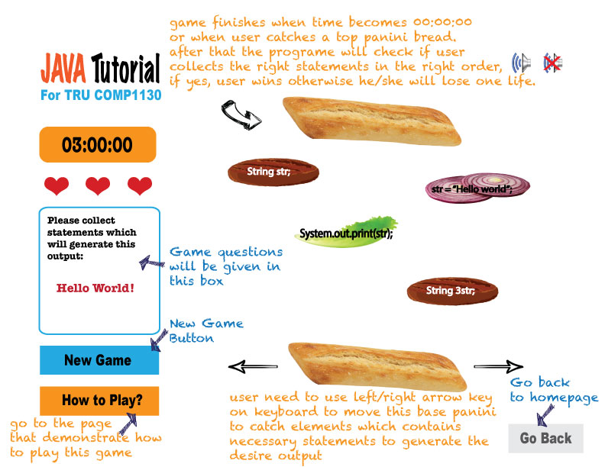
(GUI) Design (Cont.)
Initial Design

Slide 9
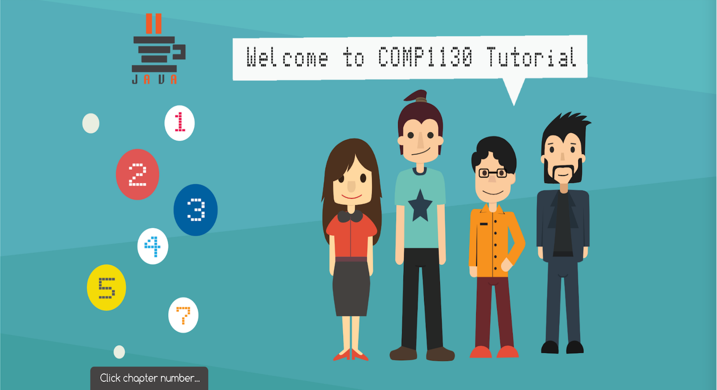
(GUI) Design (Cont.)
Final Design
Titlepage

Slide 10
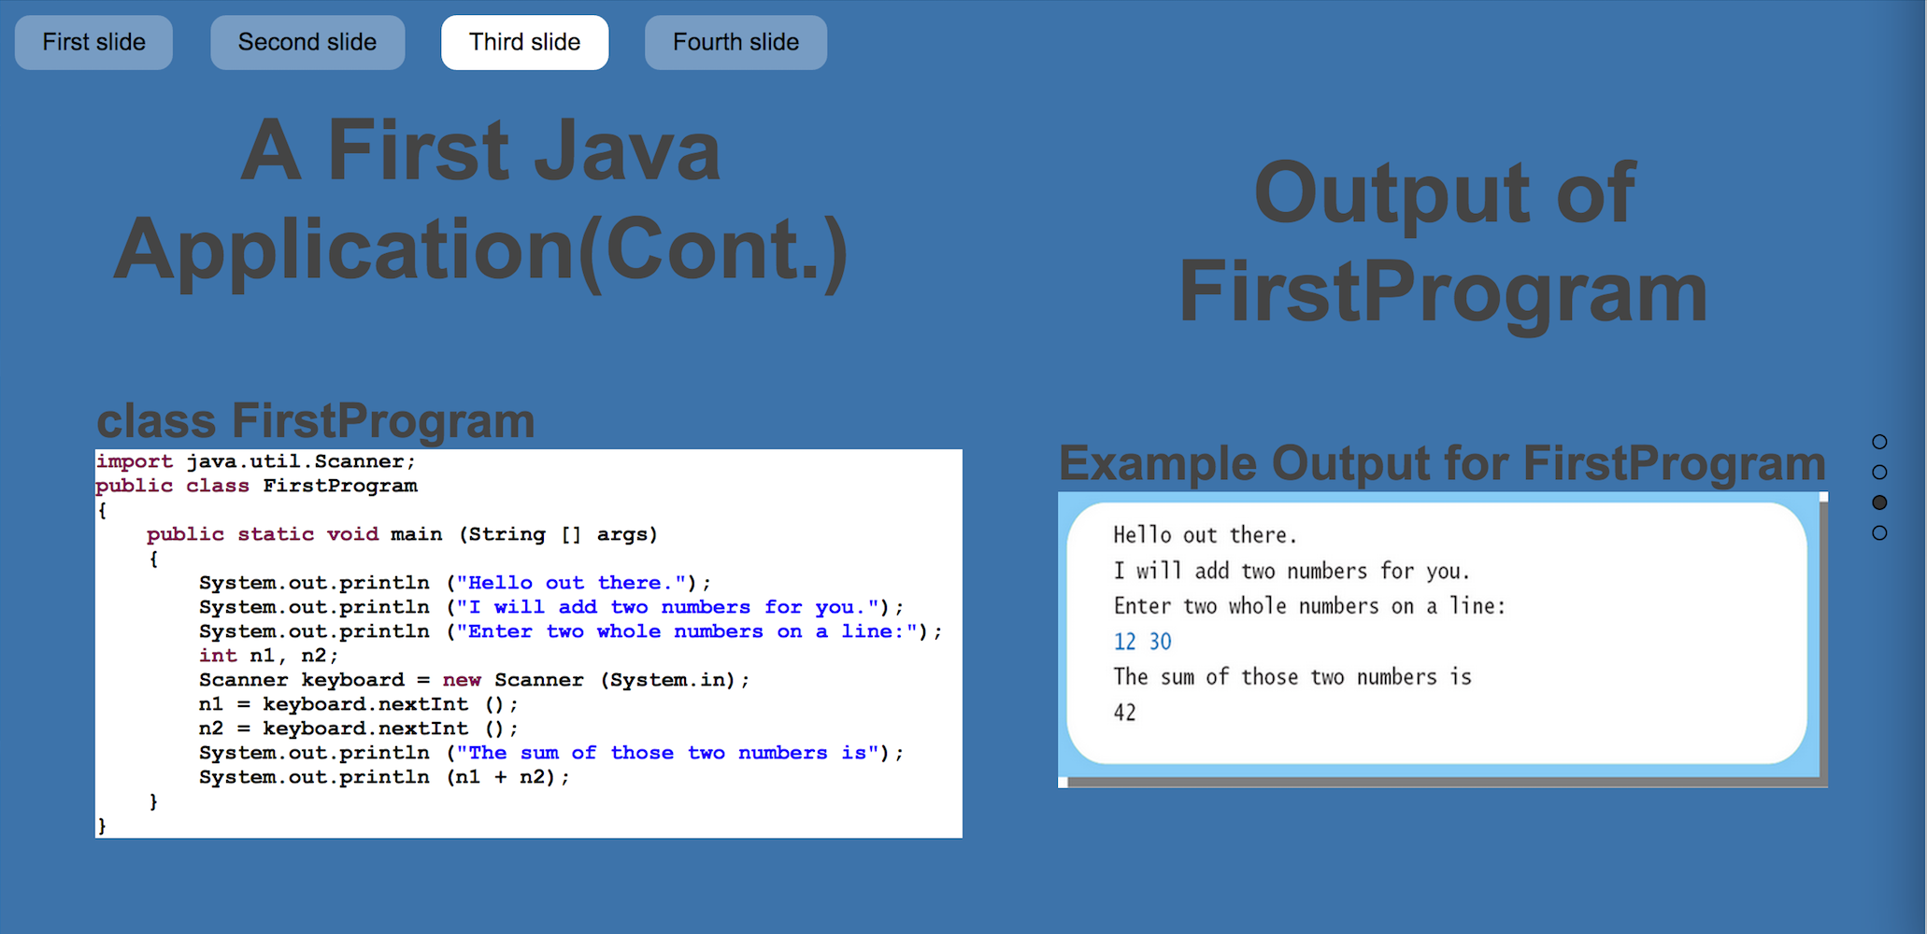
(GUI) Design (Cont.)
Final Design
Chapter page

Slide 11
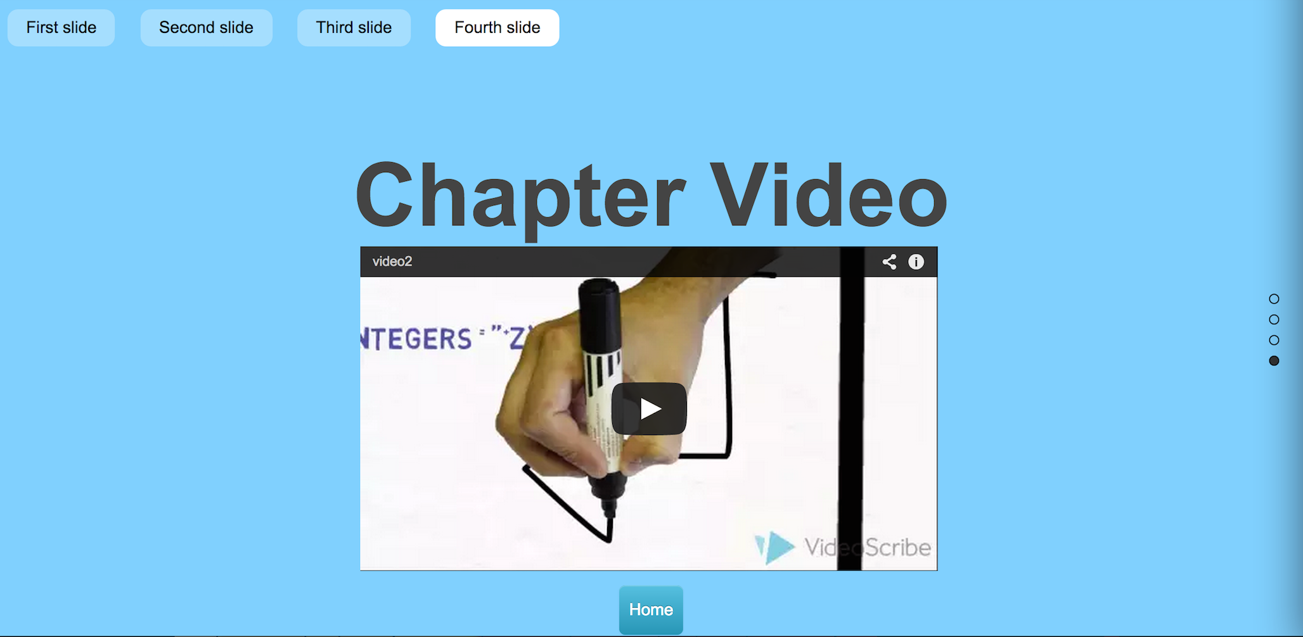
(GUI) Design (Cont.)
Final Design
Chapter page

Slide 12
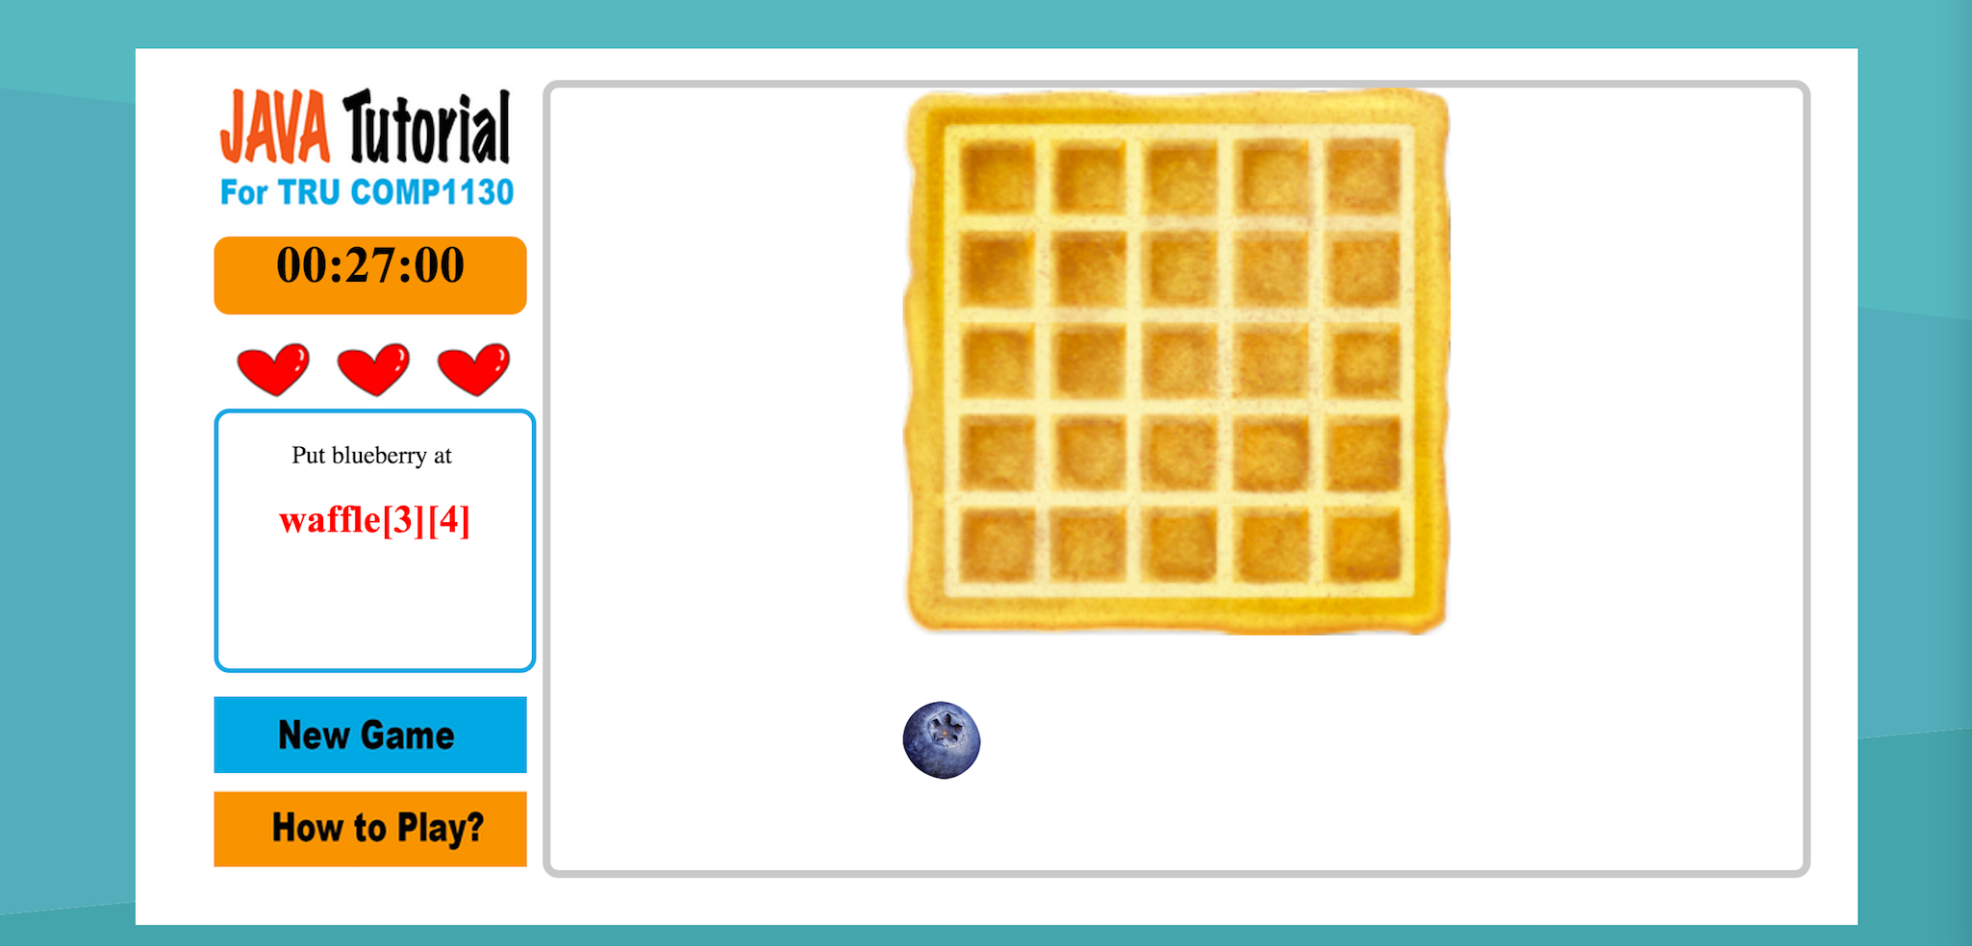
(GUI) Design (Cont.)
Final Design
Game page

Slide 13
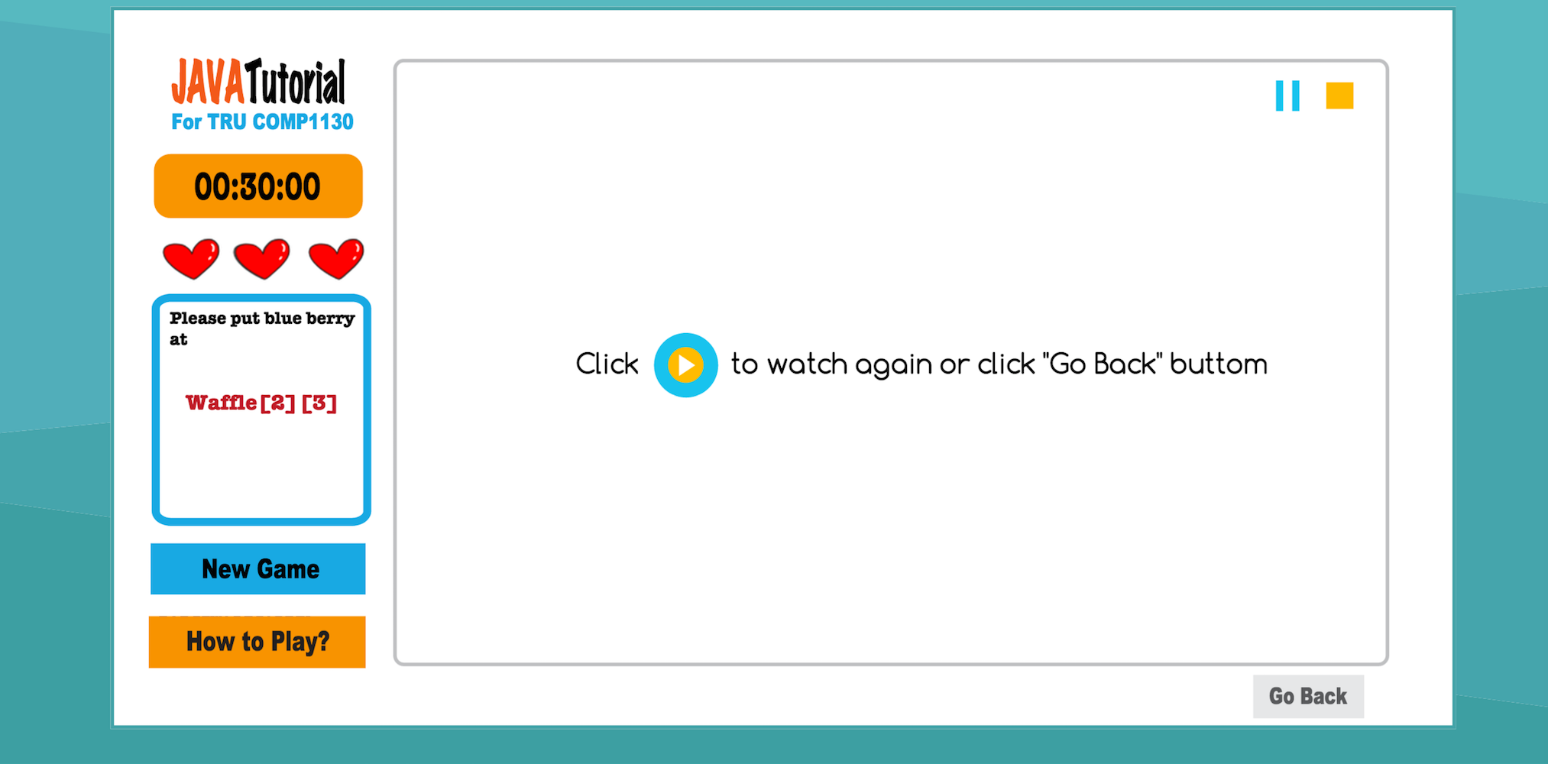
(GUI) Design (Cont.)
Final Design
Game instruction page

Slide 14
Functionality
Web Based Tutorial
Slide show with user interaction
Video tutorial
Java practice game
Game instruction
Game Play

Slide 15
Project plan
Analysis
1 week ~ 2 weeks
Design
2 weeks ~ 3 weeks (takes more time than what we was expected)
Implementation
2 weeks ~ 3 weeks (also effected by design)
Testing
1 week
Delivery
2~3 days after testing phases

Slide 16
Implementation
Facing a lot of problems
due to frequently changing design
To much contents to do, but not enough time to finish
Scale is too big
Not really facing a lot of technical problems
But screen adjusting

Slide 17
Usability test
Samples
Participants | Age | Year of program in university
P1 | 18~20 | 1ST Year
P2 | 18~20 | 1ST Year
P3 | 18~20 | 1ST Year
P4 | 21~25 | 2nd Year
P5 | 26~30 | 4th Year
P6 | 26~30 | 4th Year+

Slide 18
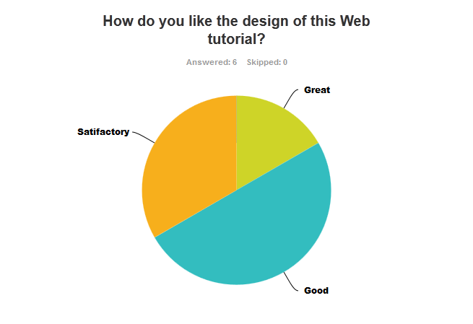
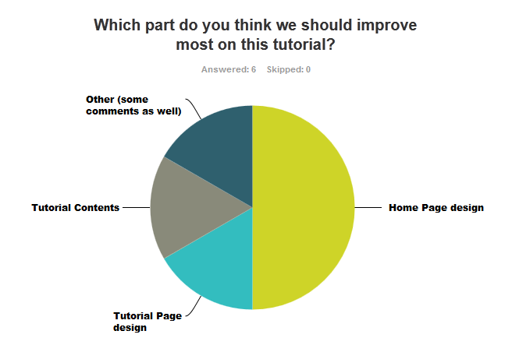
Usability test (design analysis)

Slide 19
Usability test (design analysis)
Lack of instructions on games
Poor Homepage design
Too much contents on Tutorial

Slide 20
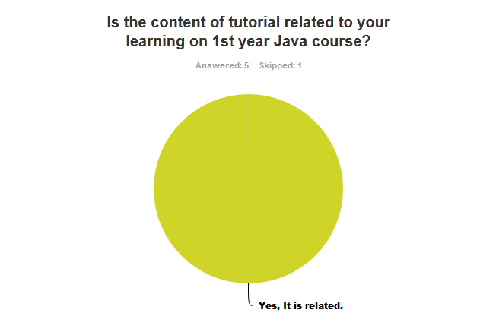
Usability test (Content Helpfulness Analysis)

Slide 21
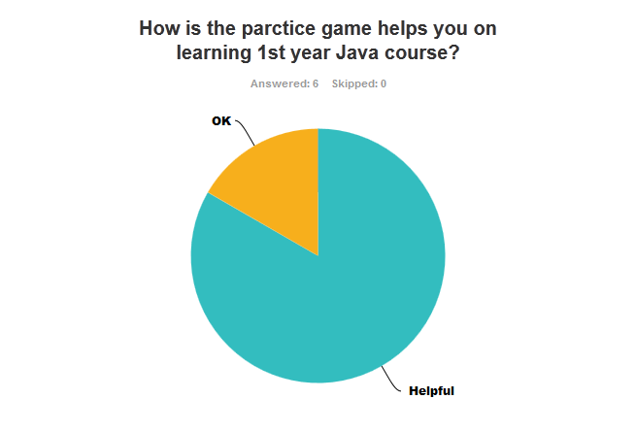
Usability Test (Content Helpfulness Analysis)
Pretty much OK
Need to add some more contents such as videos of teaching tutorial well be much helpful

Slide 22
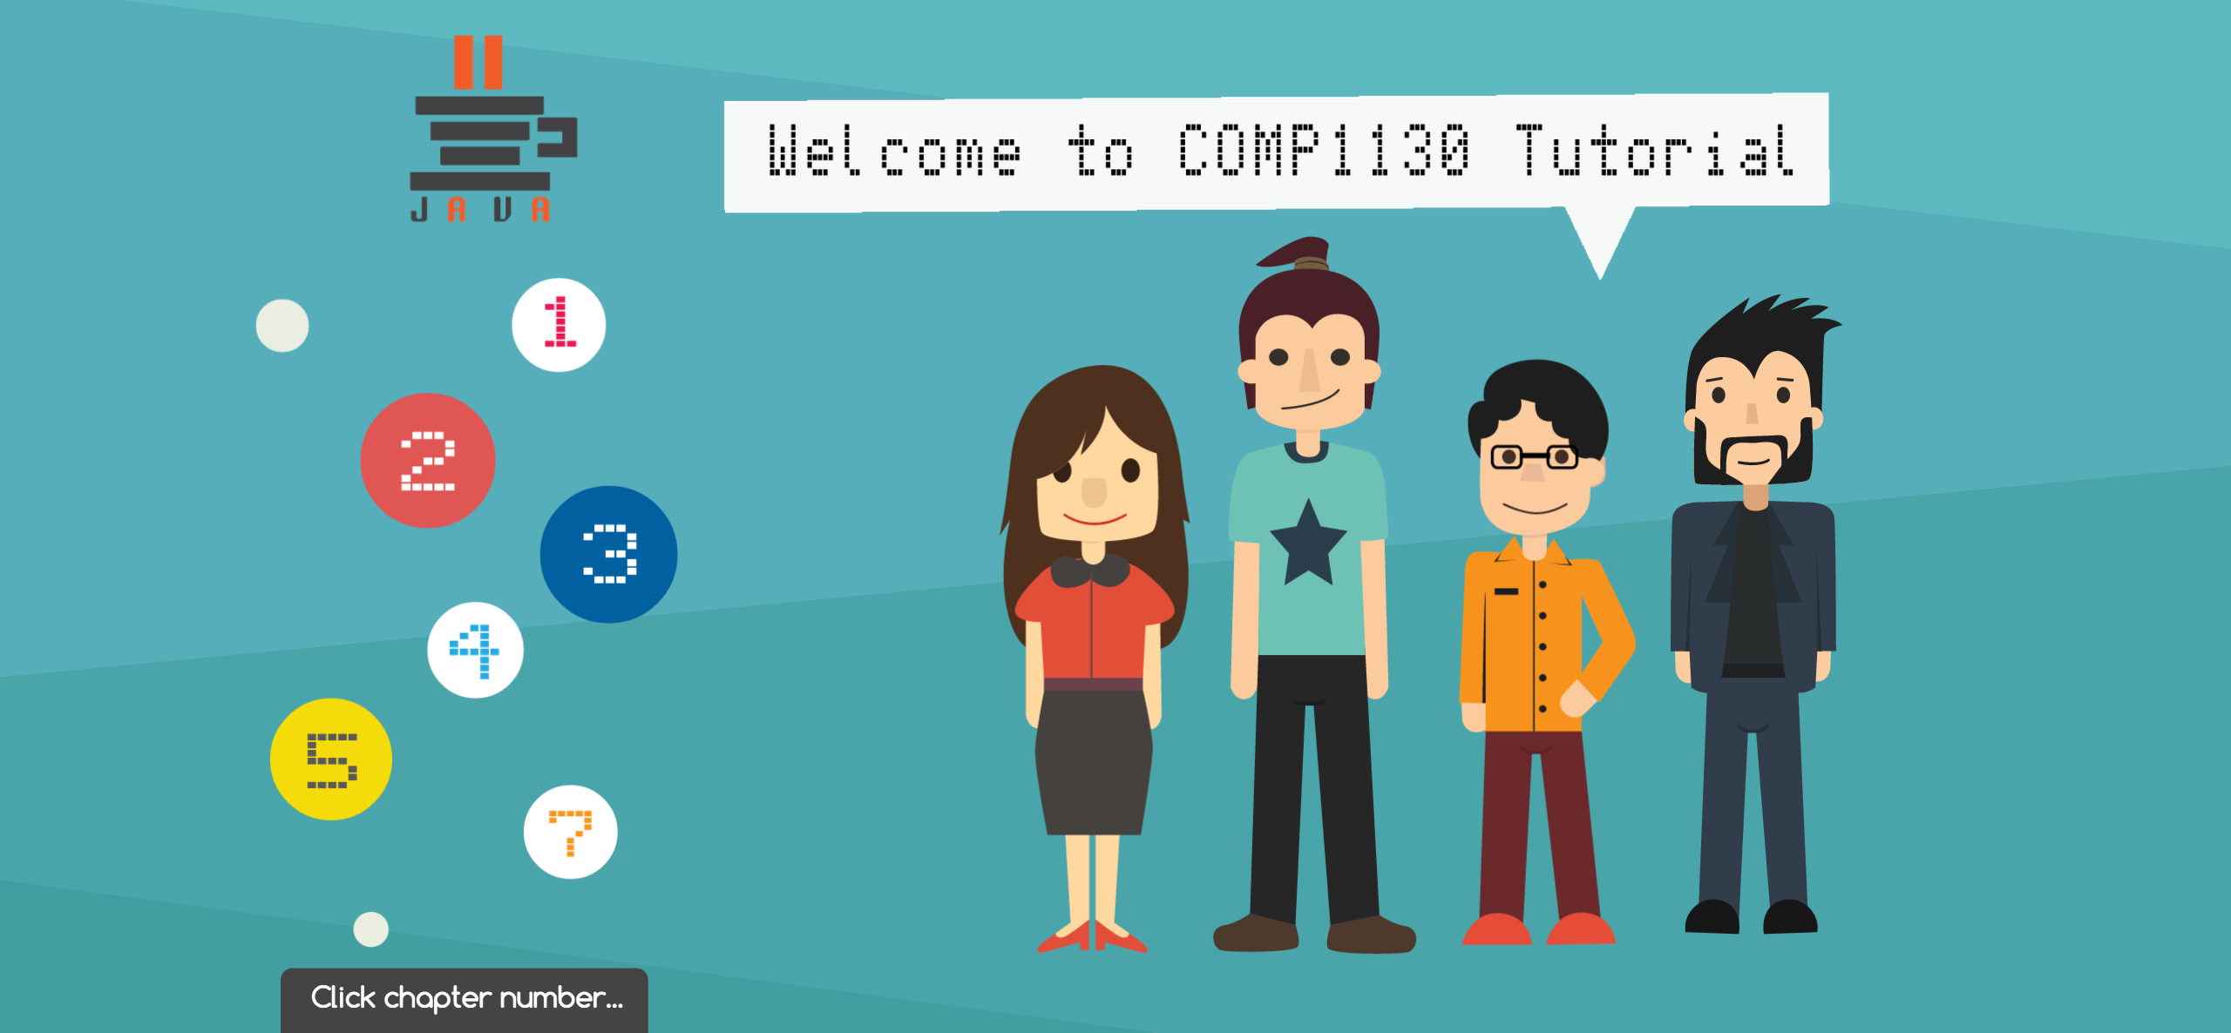
Demonstration

Slide 23
Future improvement/plan
Enhance the project’s performance
More interactive
Add a Compiler to the tutorials
Able to modify the code in the tutorials
And then Generate the output after modification
Small quizzes for each Chapter
More games

Slide 24
What you learned from the project
Adobe Creative Cloud Tools
Edge Animate CC
Illustrator CC
Photoshop CC
Premiere Pro CC
Etc.
Better user experience & user friendly product

